Slide 1
Report on expenses
The subtle art of tracking your expenses and finding the potential of reducing them

Slide 2
How can I increase my savings?
Questions:
What are the categories I spend on?
What categories can be reduced?
Is it possible to reduce my spendings by 10%?
Preparation:
Timeline: 3 months (September-October-November)
Identifying categories:
Home
Bills
Transportation
Groceries
Leisure time
Going out
Self-improvement
Healthcare
Other
Data collection method: Recording all transactions in an application -> exporting data to spreadsheet

Slide 3
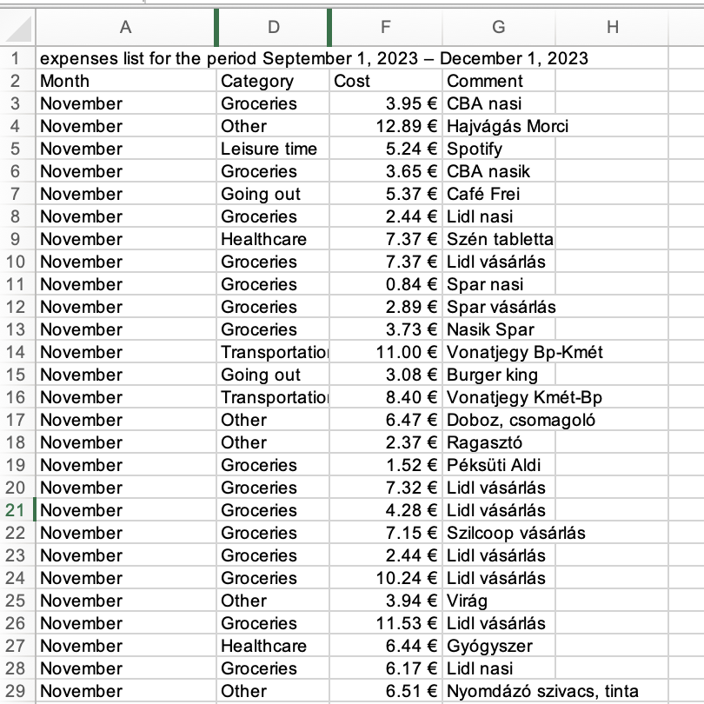
PROCESSING AND Analyzing data
Total | Column Labels
Row Labels | September | October | November | Grand Total
Bills | 83.80 € | 87.44 € | 77.06 € | 248.31 €
Clothing | 21.46 € | 15.92 € | 7.11 € | 44.49 €
Going out | 97.37 € | 115.76 € | 40.13 € | 253.26 €
Groceries | 133.39 € | 173.44 € | 173.57 € | 480.39 €
Healthcare | 10.65 € | 23.34 € | 55.91 € | 89.90 €
Home | 157.89 € | 157.89 € | 157.89 € | 473.68 €
Leisure time | 8.54 € | 107.05 € | 5.24 € | 120.83 €
Other | 57.66 € | 83.06 € | 45.09 € | 185.81 €
Transportation | 22.48 € | 92.36 € | 76.87 € | 191.71 €
Grand Total | 593.25 € | 856.26 € | 638.87 € | 2,088.38 €

Slide 4
PROCESSING AND Analyzing data
Observations:
Home, bills more or less standard - Fix
October trip resulted an increase in many categories:
Going out
Leisure time
Other
Transportation
Clothing – low with low fluctuation
Going out and Groceries have a correlation – high with high fluctuation
Transportation – high fluctuation
Avarage: 696.13 € -> 10%: ∼70 €
593.25 €

Slide 5
solution
Options:
Transportation (∼ 30-40 €): use a bike instead of public transportation
Food (∼ 30-40 €):
plan the cooking ahead
less going out to eat
eliminate certain items (impulse shopping)
choosing cheaper but good quality goods
Bills (∼ 10 €): checking other phone packages
Other (∼ 30 €): investigate what items are unnecessary
593.25 €

